Slide 1
Malaria and maritime traffic on the Colombian Pacific coast?
Aimee R. Taylor
Diego F. Echevarry
Timothy J. Anderson
Daniel E. Neafsey
Caroline O. Buckee

Slide 2
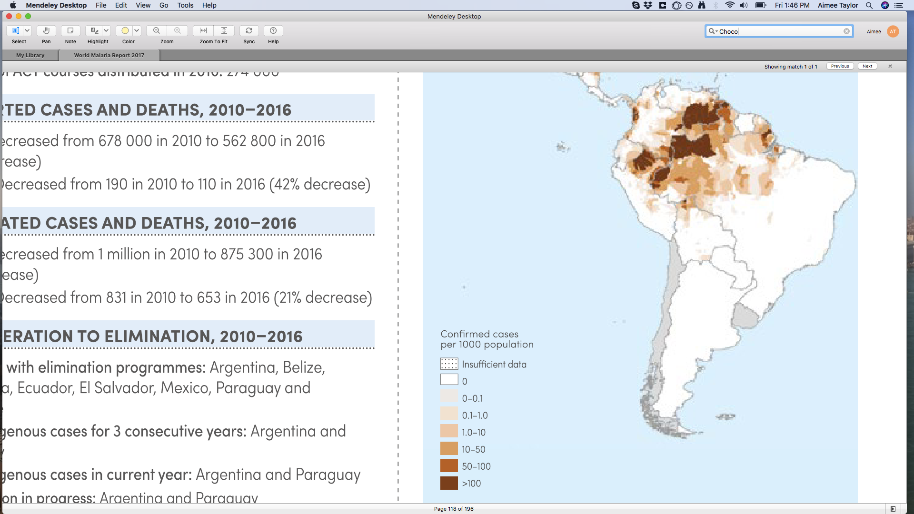
Colombia
﻿World Malaria Report 2017
Malaria incidence almost halved between 2010-2016
However, cases doubled between 2015 and 2016
More P. falciparum than P. vivax in 2016
Hotspot of transmission: Choco
Notes:
P. Facliparum < P. Vivax in 2010
P. Facliparum > P. Vivax in 2016
Begs the question: impact of human mobility?

Slide 3
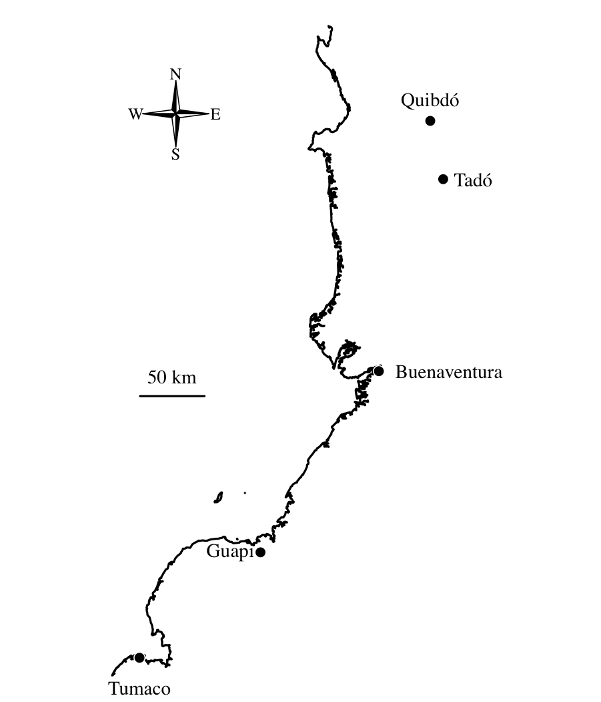
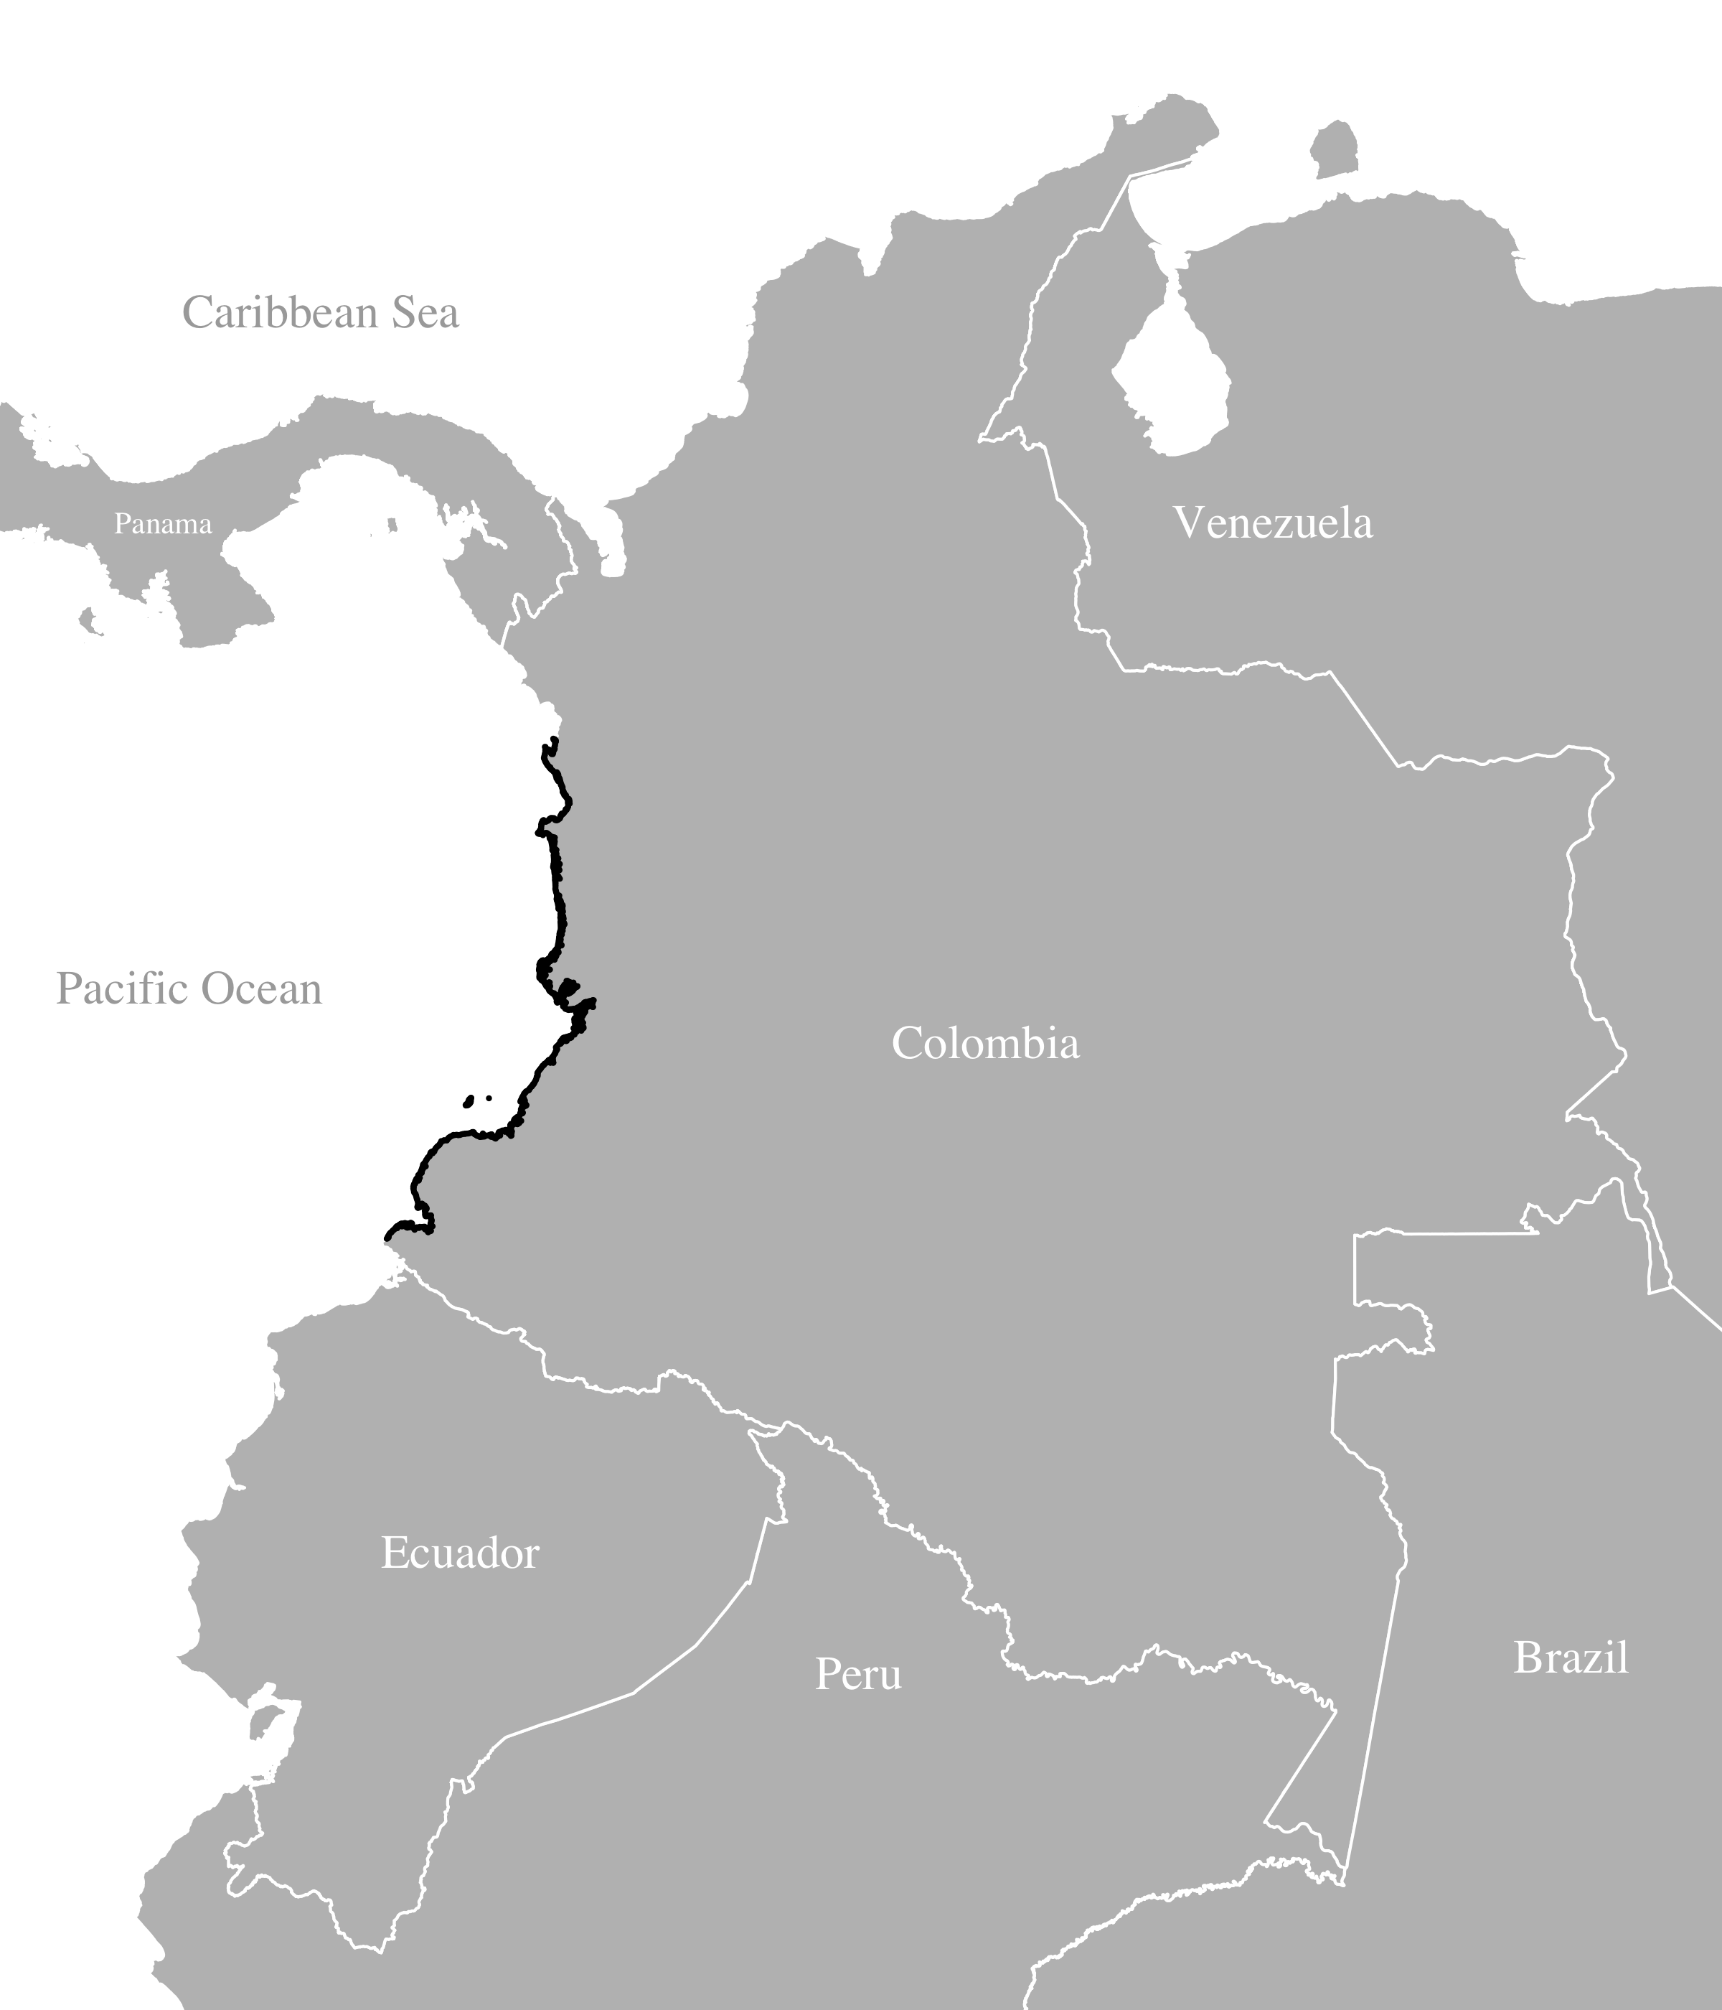
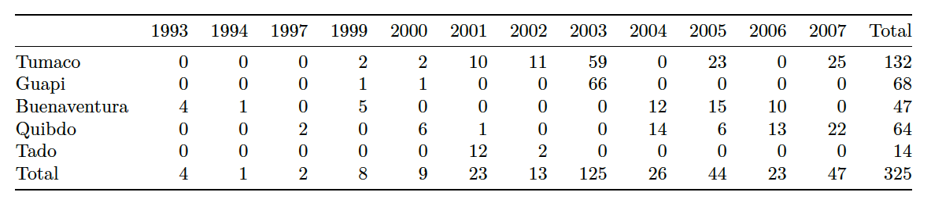
Previously published P. falciparum data from the Colombian Pacific Coast
325 single-genotype parasite samples collected between 1993 and 2007 and genotyped at 250 single nucleotide polymorphisms (SNPs)
Echeverry,D.F. et al. (2013) BMC Genet.
Notes:
Collected to better understand the population structure of Colombian Plasmodium falciparum in preparation for genotype-phentotype studies of Colombian samples
Long term persistence of clonal malaria parasite Plasmodium falciparum lineages in the ColombianPacific region
Cases per 1000 inhabitants highest in Choco (10-20 cases per year) and Nariño (approx. 10) other < 5
"Colombia has approximately 100,000 malaria cases per year and >60%" of the population is at risk. Unstable transmission, all ages, mostly symptomatic.
Previous studies in Colombia have shown low genetic diversity, "low levels of multiclonal infections. 90% of population in the data-collaction region are Afro-Colombians.
A set of 384 SNPs were genotyped in blood spot DNA samples from 447 P. falciparum infected subjects collected over a ten year period from four provinces of the Colombian Pacific coast to evaluate clonality, population structure and linkage disequilibrium (LD). Most infections (81%) contained a single predominant clone. These clustered into 136 multilocus genotypes (MLGs), with 32% of MLGs recovered from multiple (2 – 28) independent subjects. We observed extremely low genotypic richness (R = 0.42) and long persistence of MLGs through time (median = 537 days, range = 1 – 2,997 days). There was a high probability (>5%) of sampling parasites from the same MLG in different subjects within 28 days, suggesting caution is needed when using genotyping methods to assess treatment success in clinical drug trials. Panmixia was rejected as four well differentiated subpopulations (FST = 0.084 - 0.279) were identified. These occurred sympatrically but varied in frequency within the four provinces. Linkage disequilibrium (LD) decayed more rapidly (r2 = 0.17 for markers <10 kb apart) than observed previously in South American samples.

Slide 4
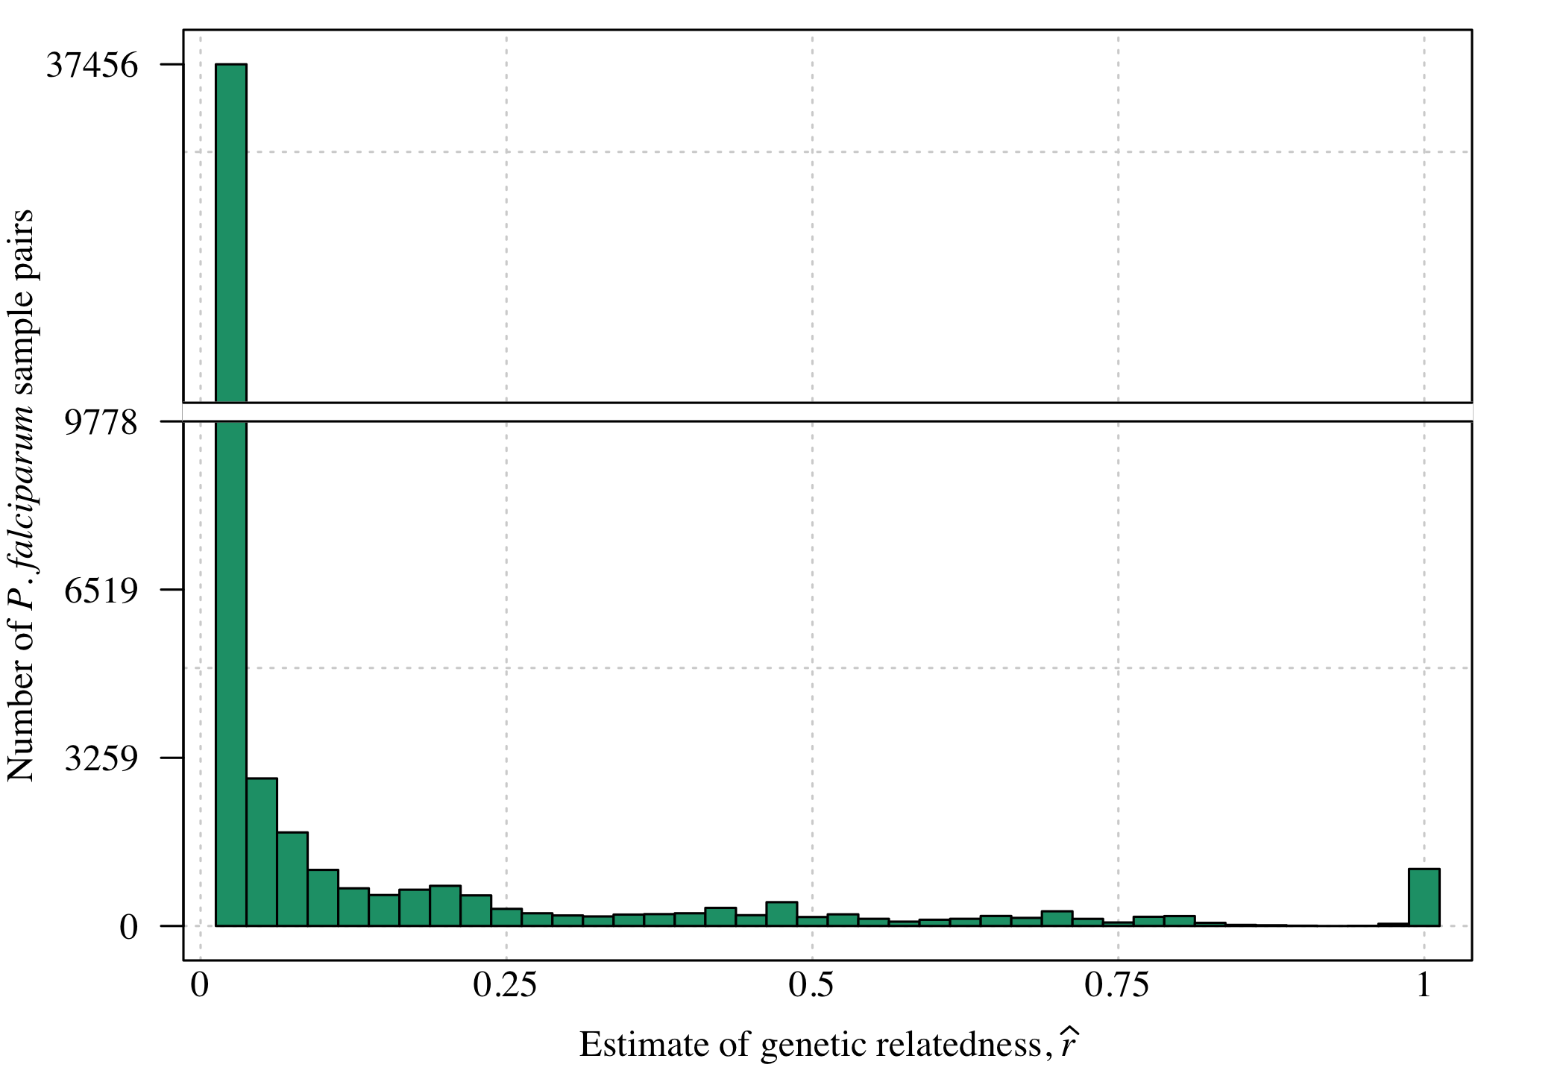
Distribution of estimates genetic relatedness, r for all pairwise comparisons of samples
﻿hmmIBD: Schaffner, et al. (2018)

Slide 5
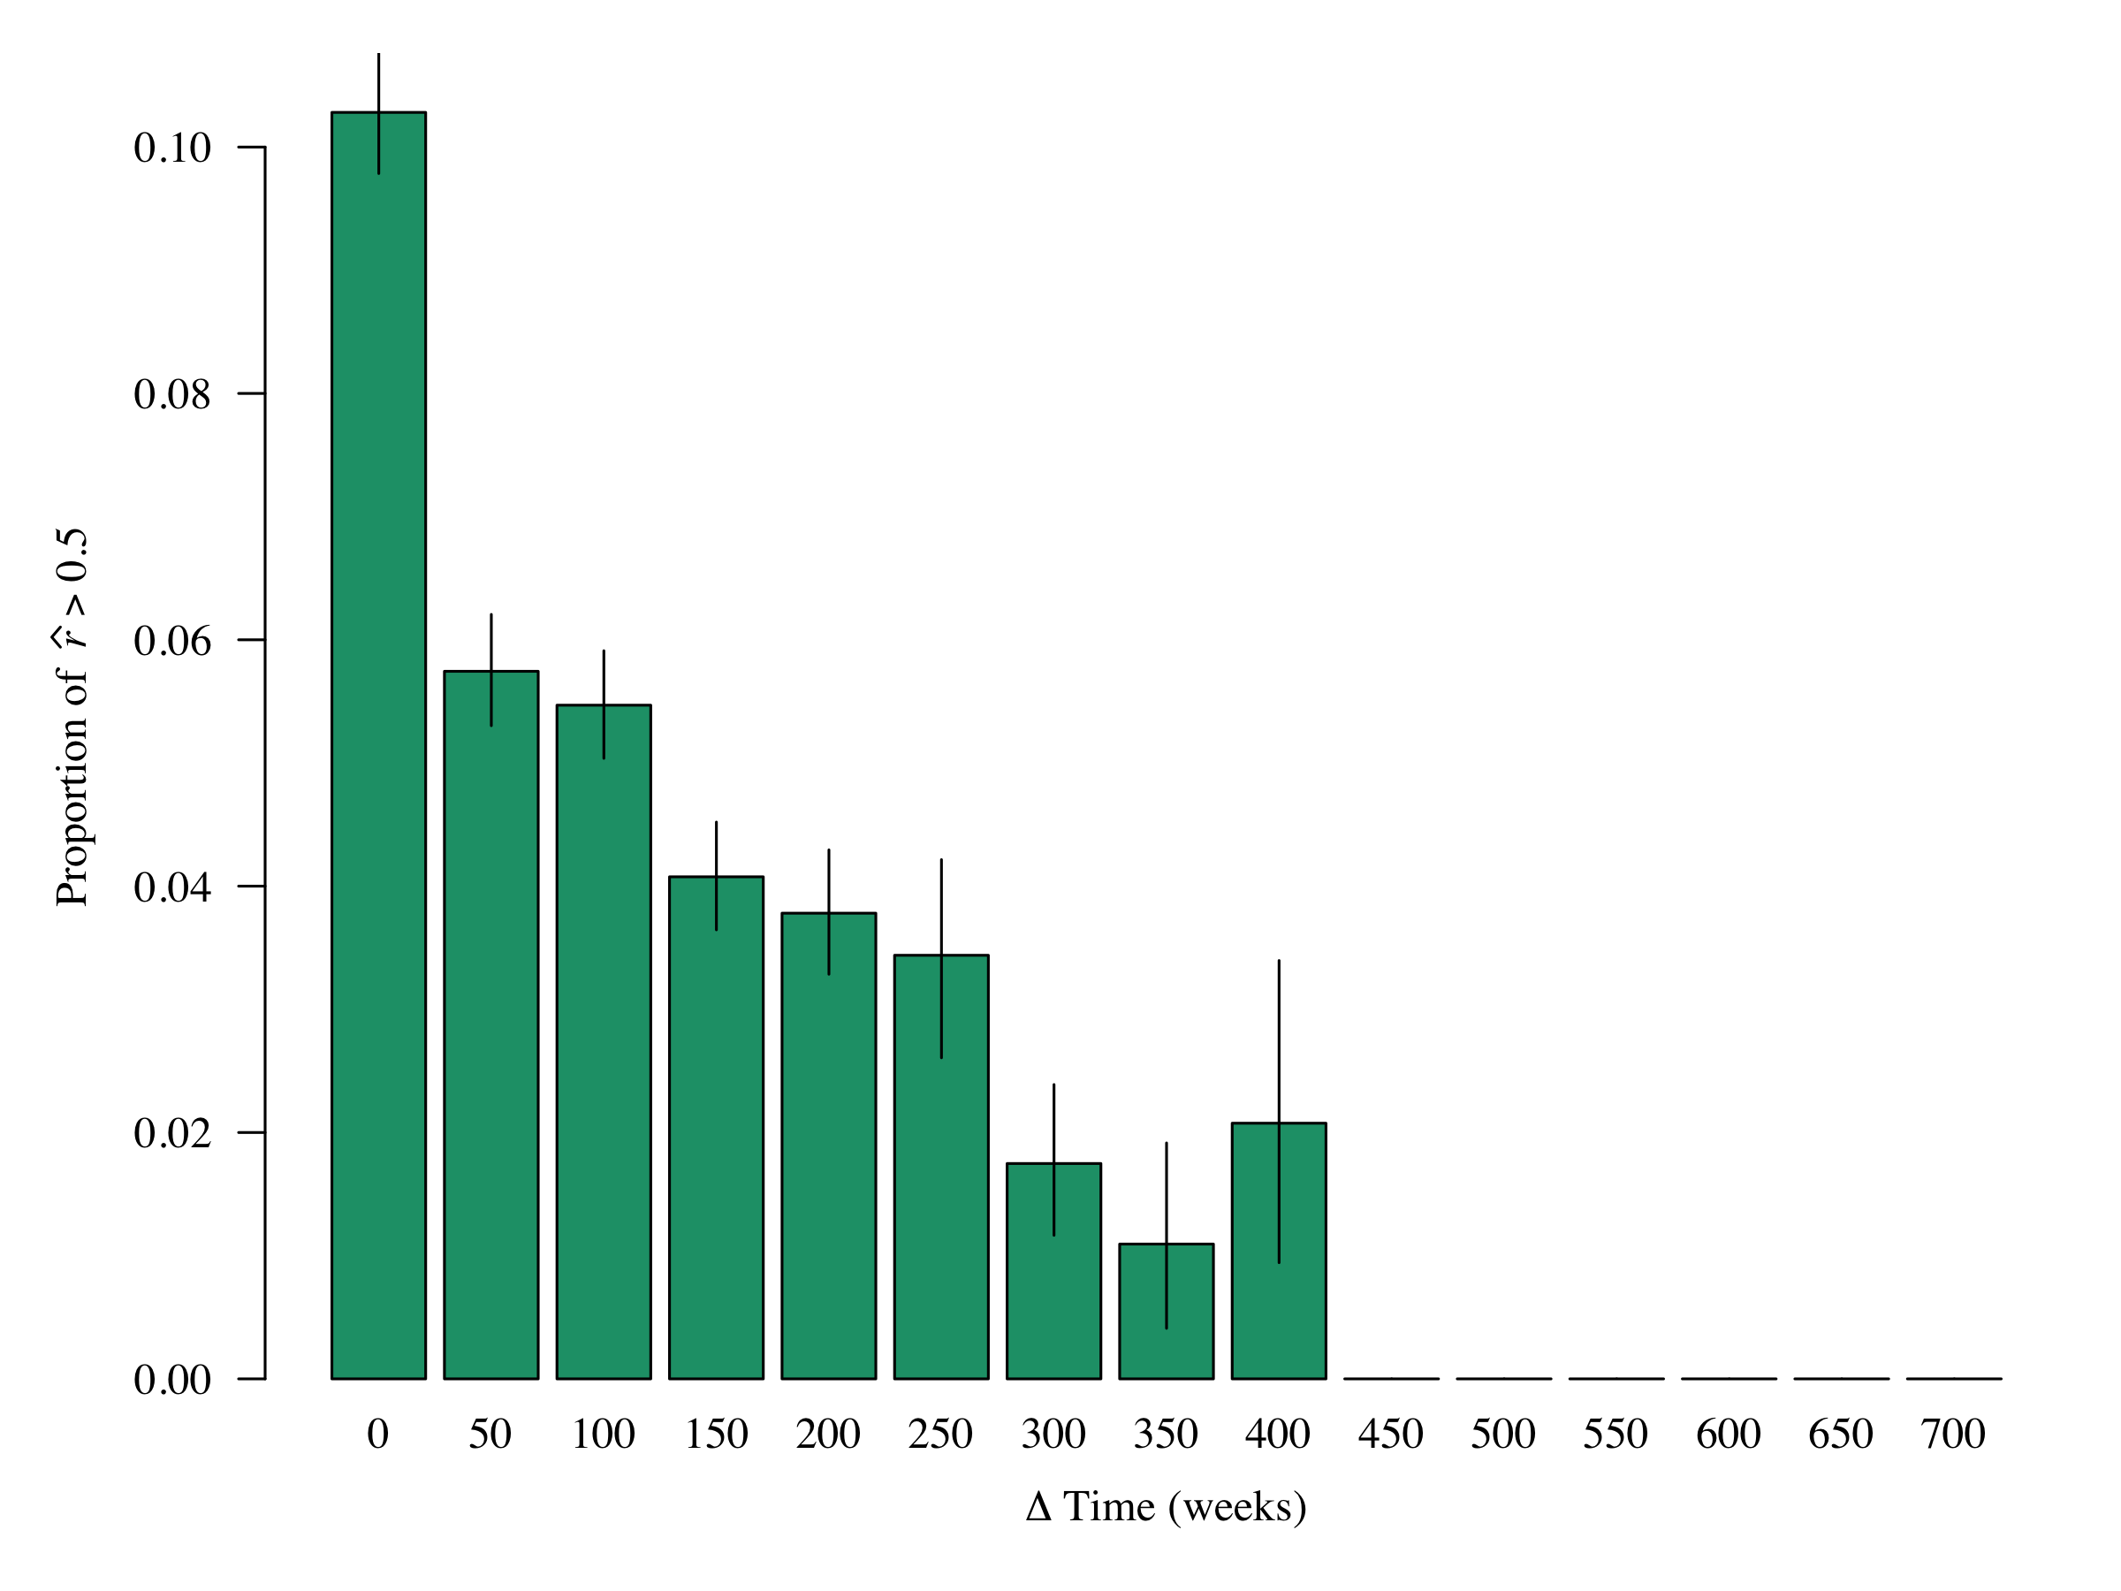
P. falciparum sample pairs more highly related (> 0.5) if collected closer together in time
Unpublished

Slide 6
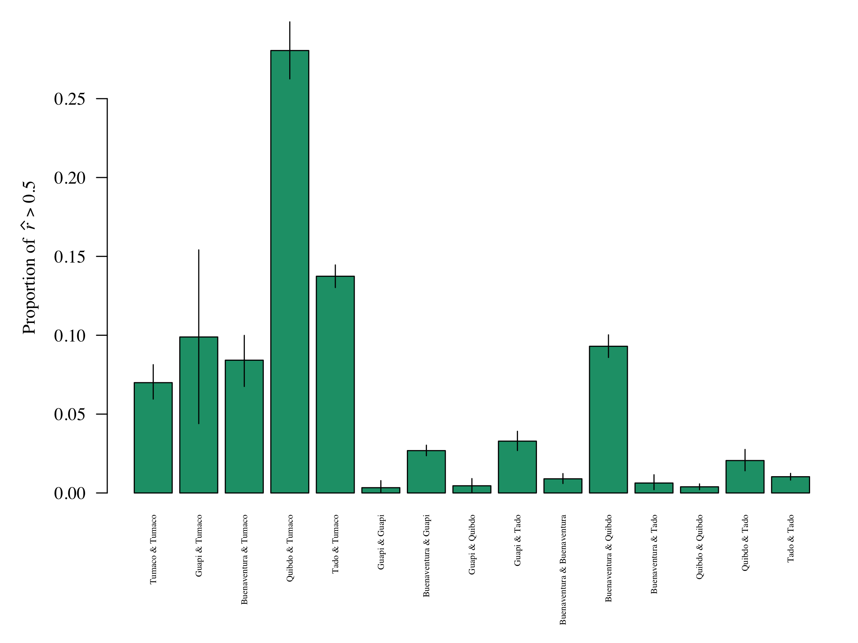
P. falciparum sample pairs more highly related (> 0.5) if collected closer together in space
Across cities
Unpublished

Slide 7
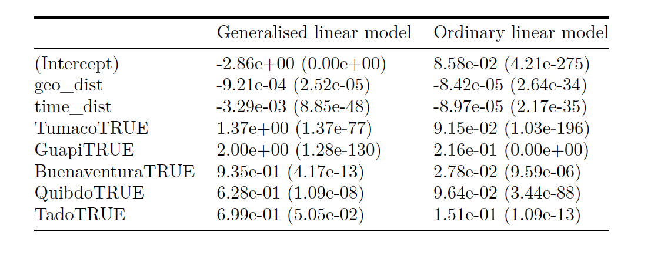
Regression analyses support small but significant negative trends in relatedness with both space and time
Fit to highly related versus not
Fit to r estimates directly
Unpublished

Slide 8
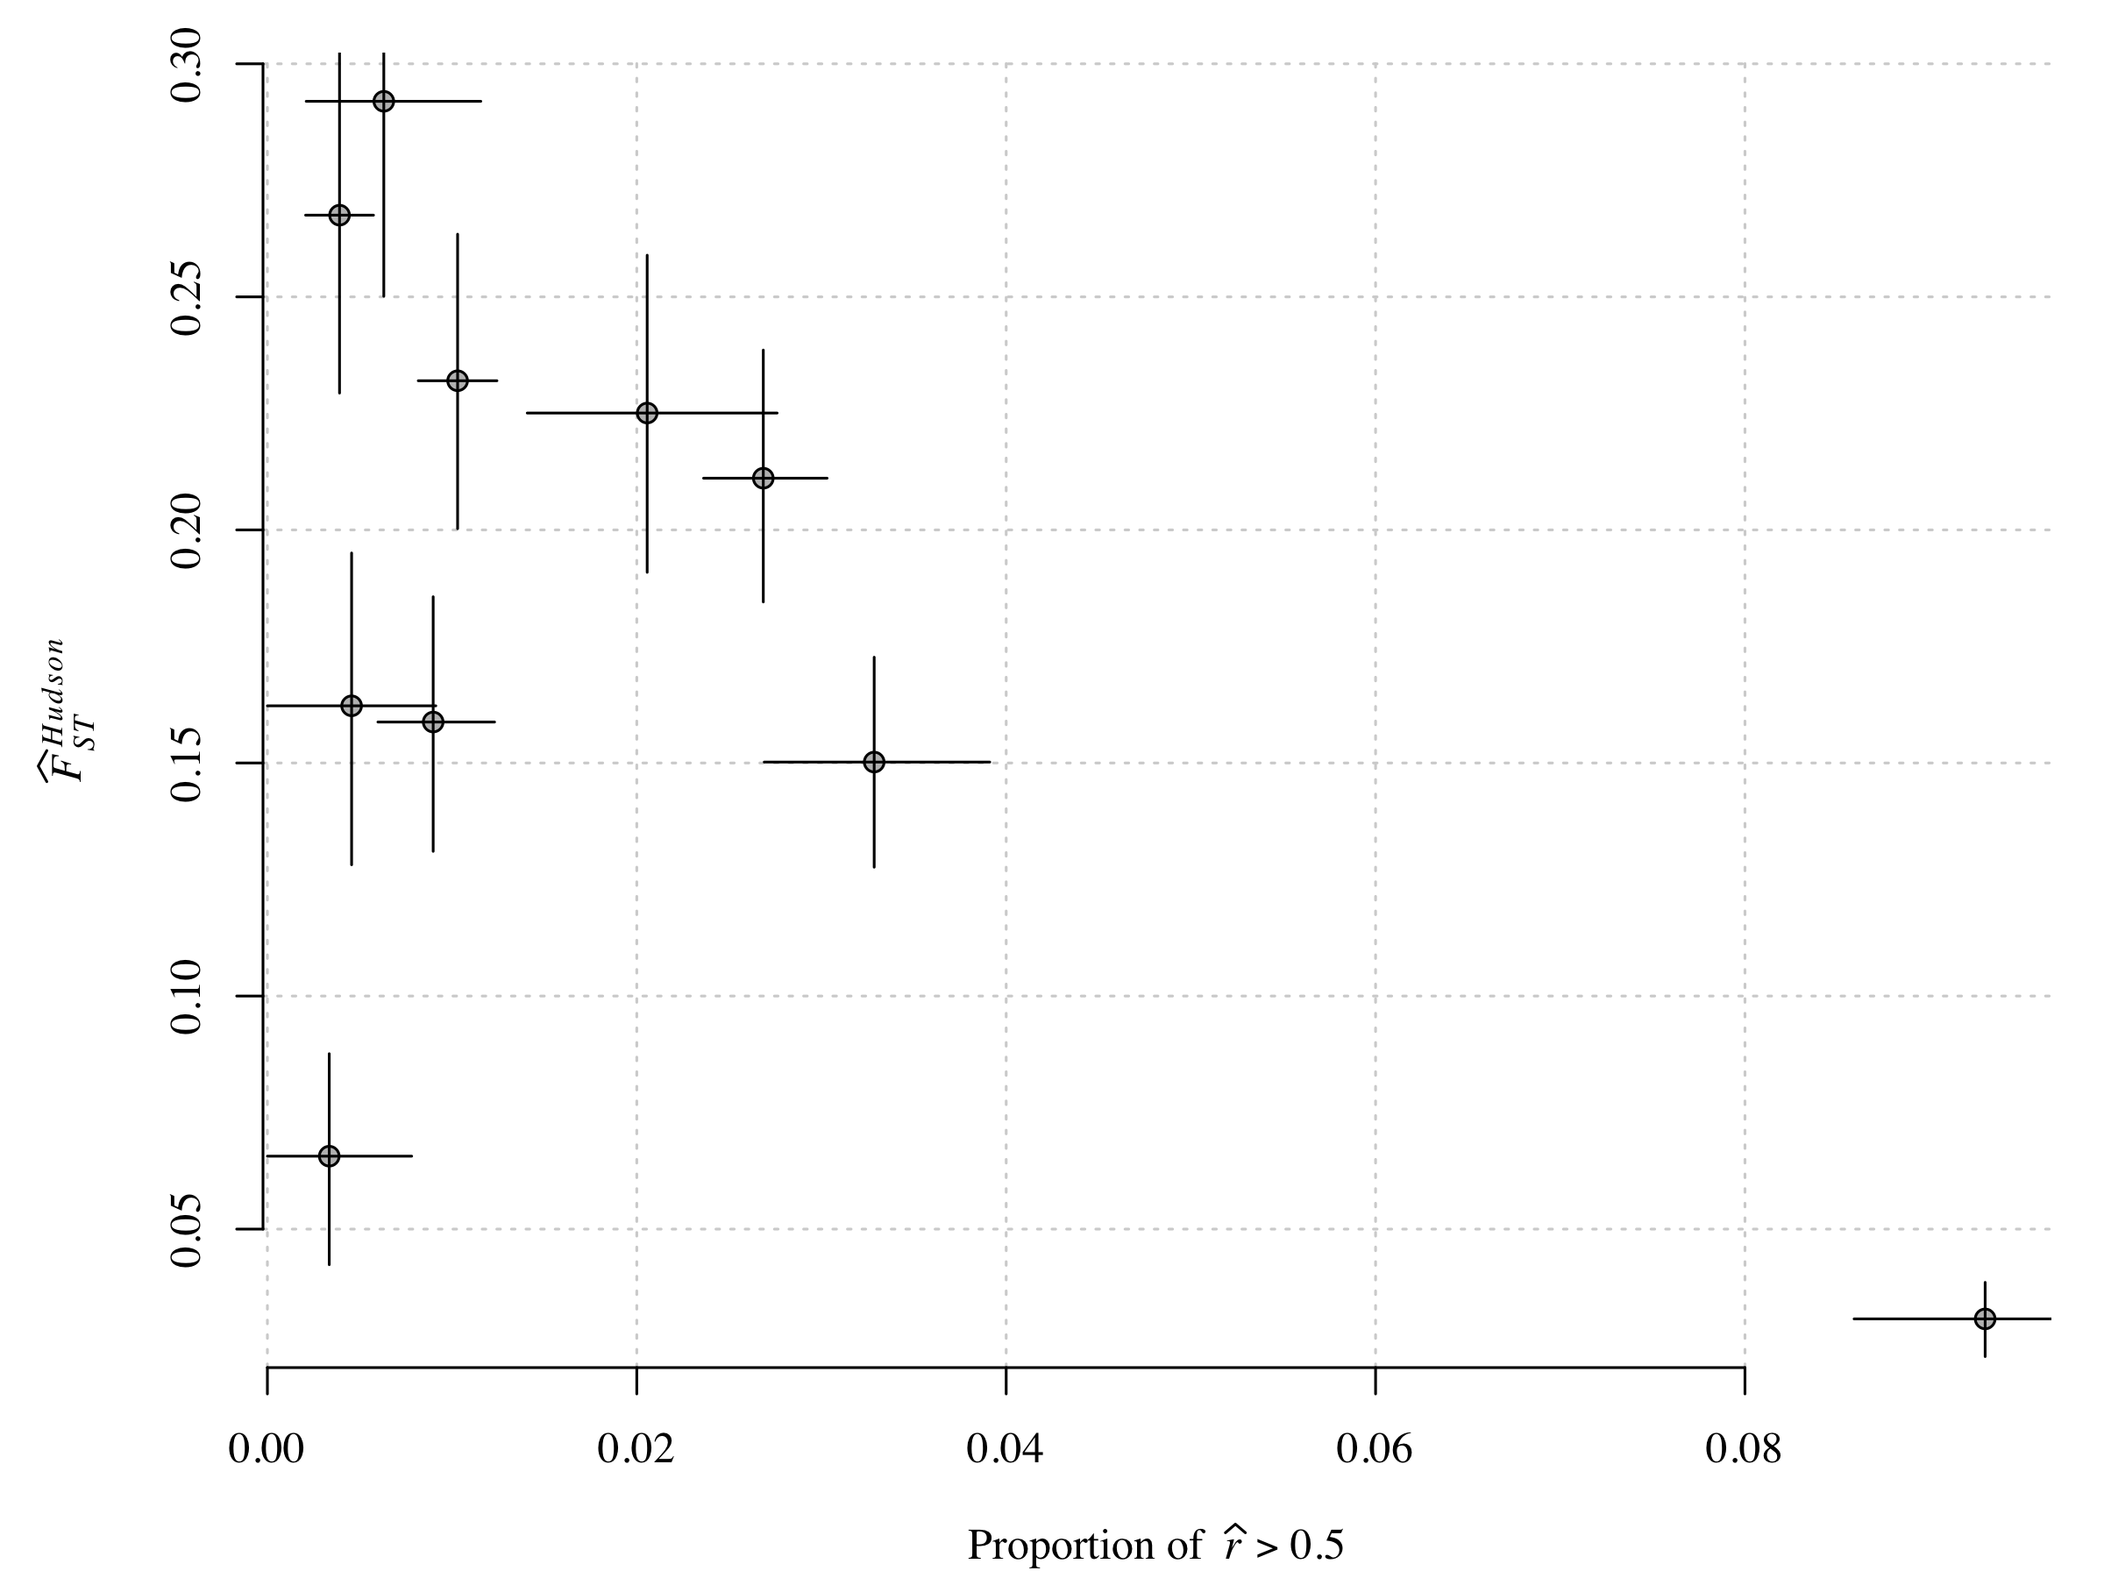
Previously published F_{ST} analyses agree

Slide 9
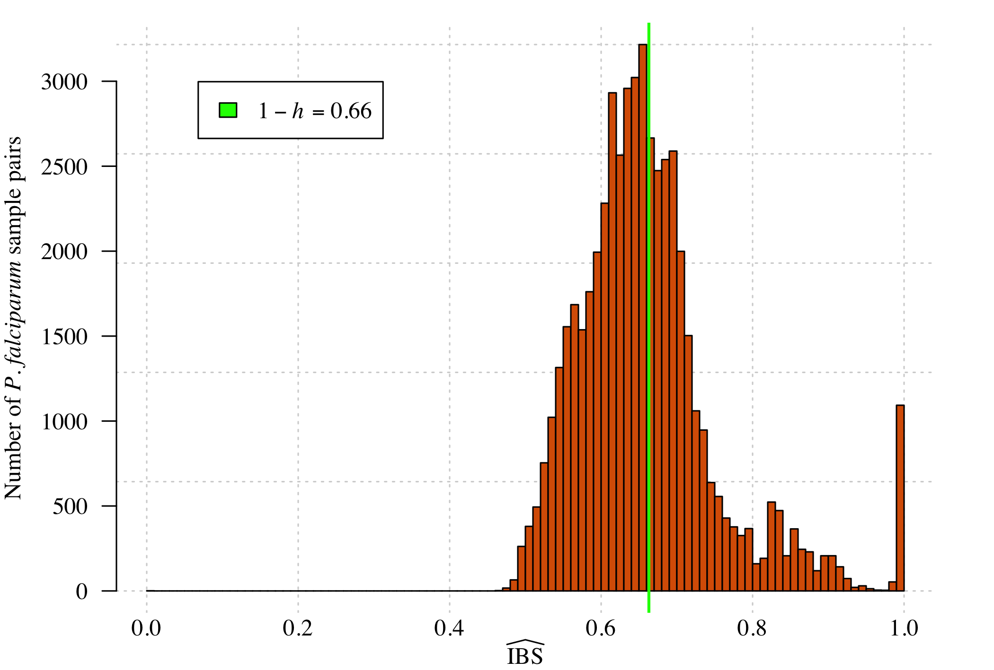
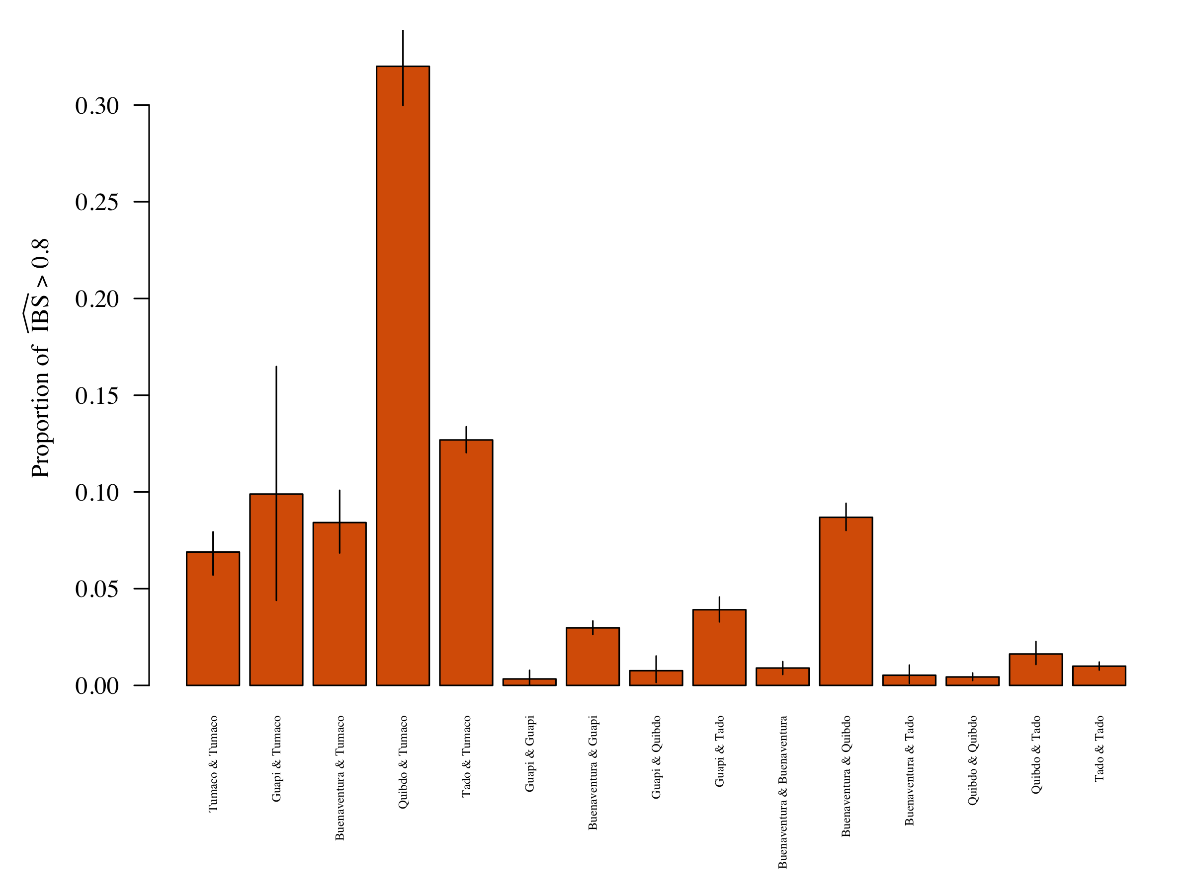
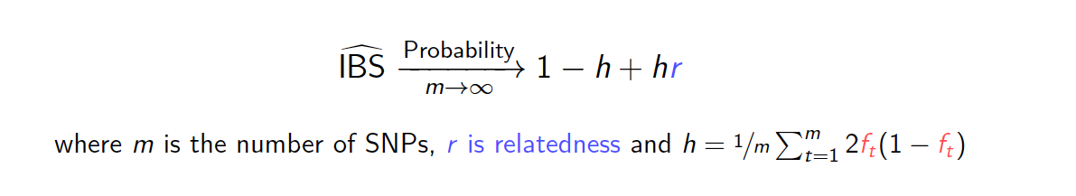
Aside: Identity-by-state (IBS) estimates generate similar results vastly different distribution
f_{t} is the allele frequency at the t^{th} SNP
Unpublished

Slide 10
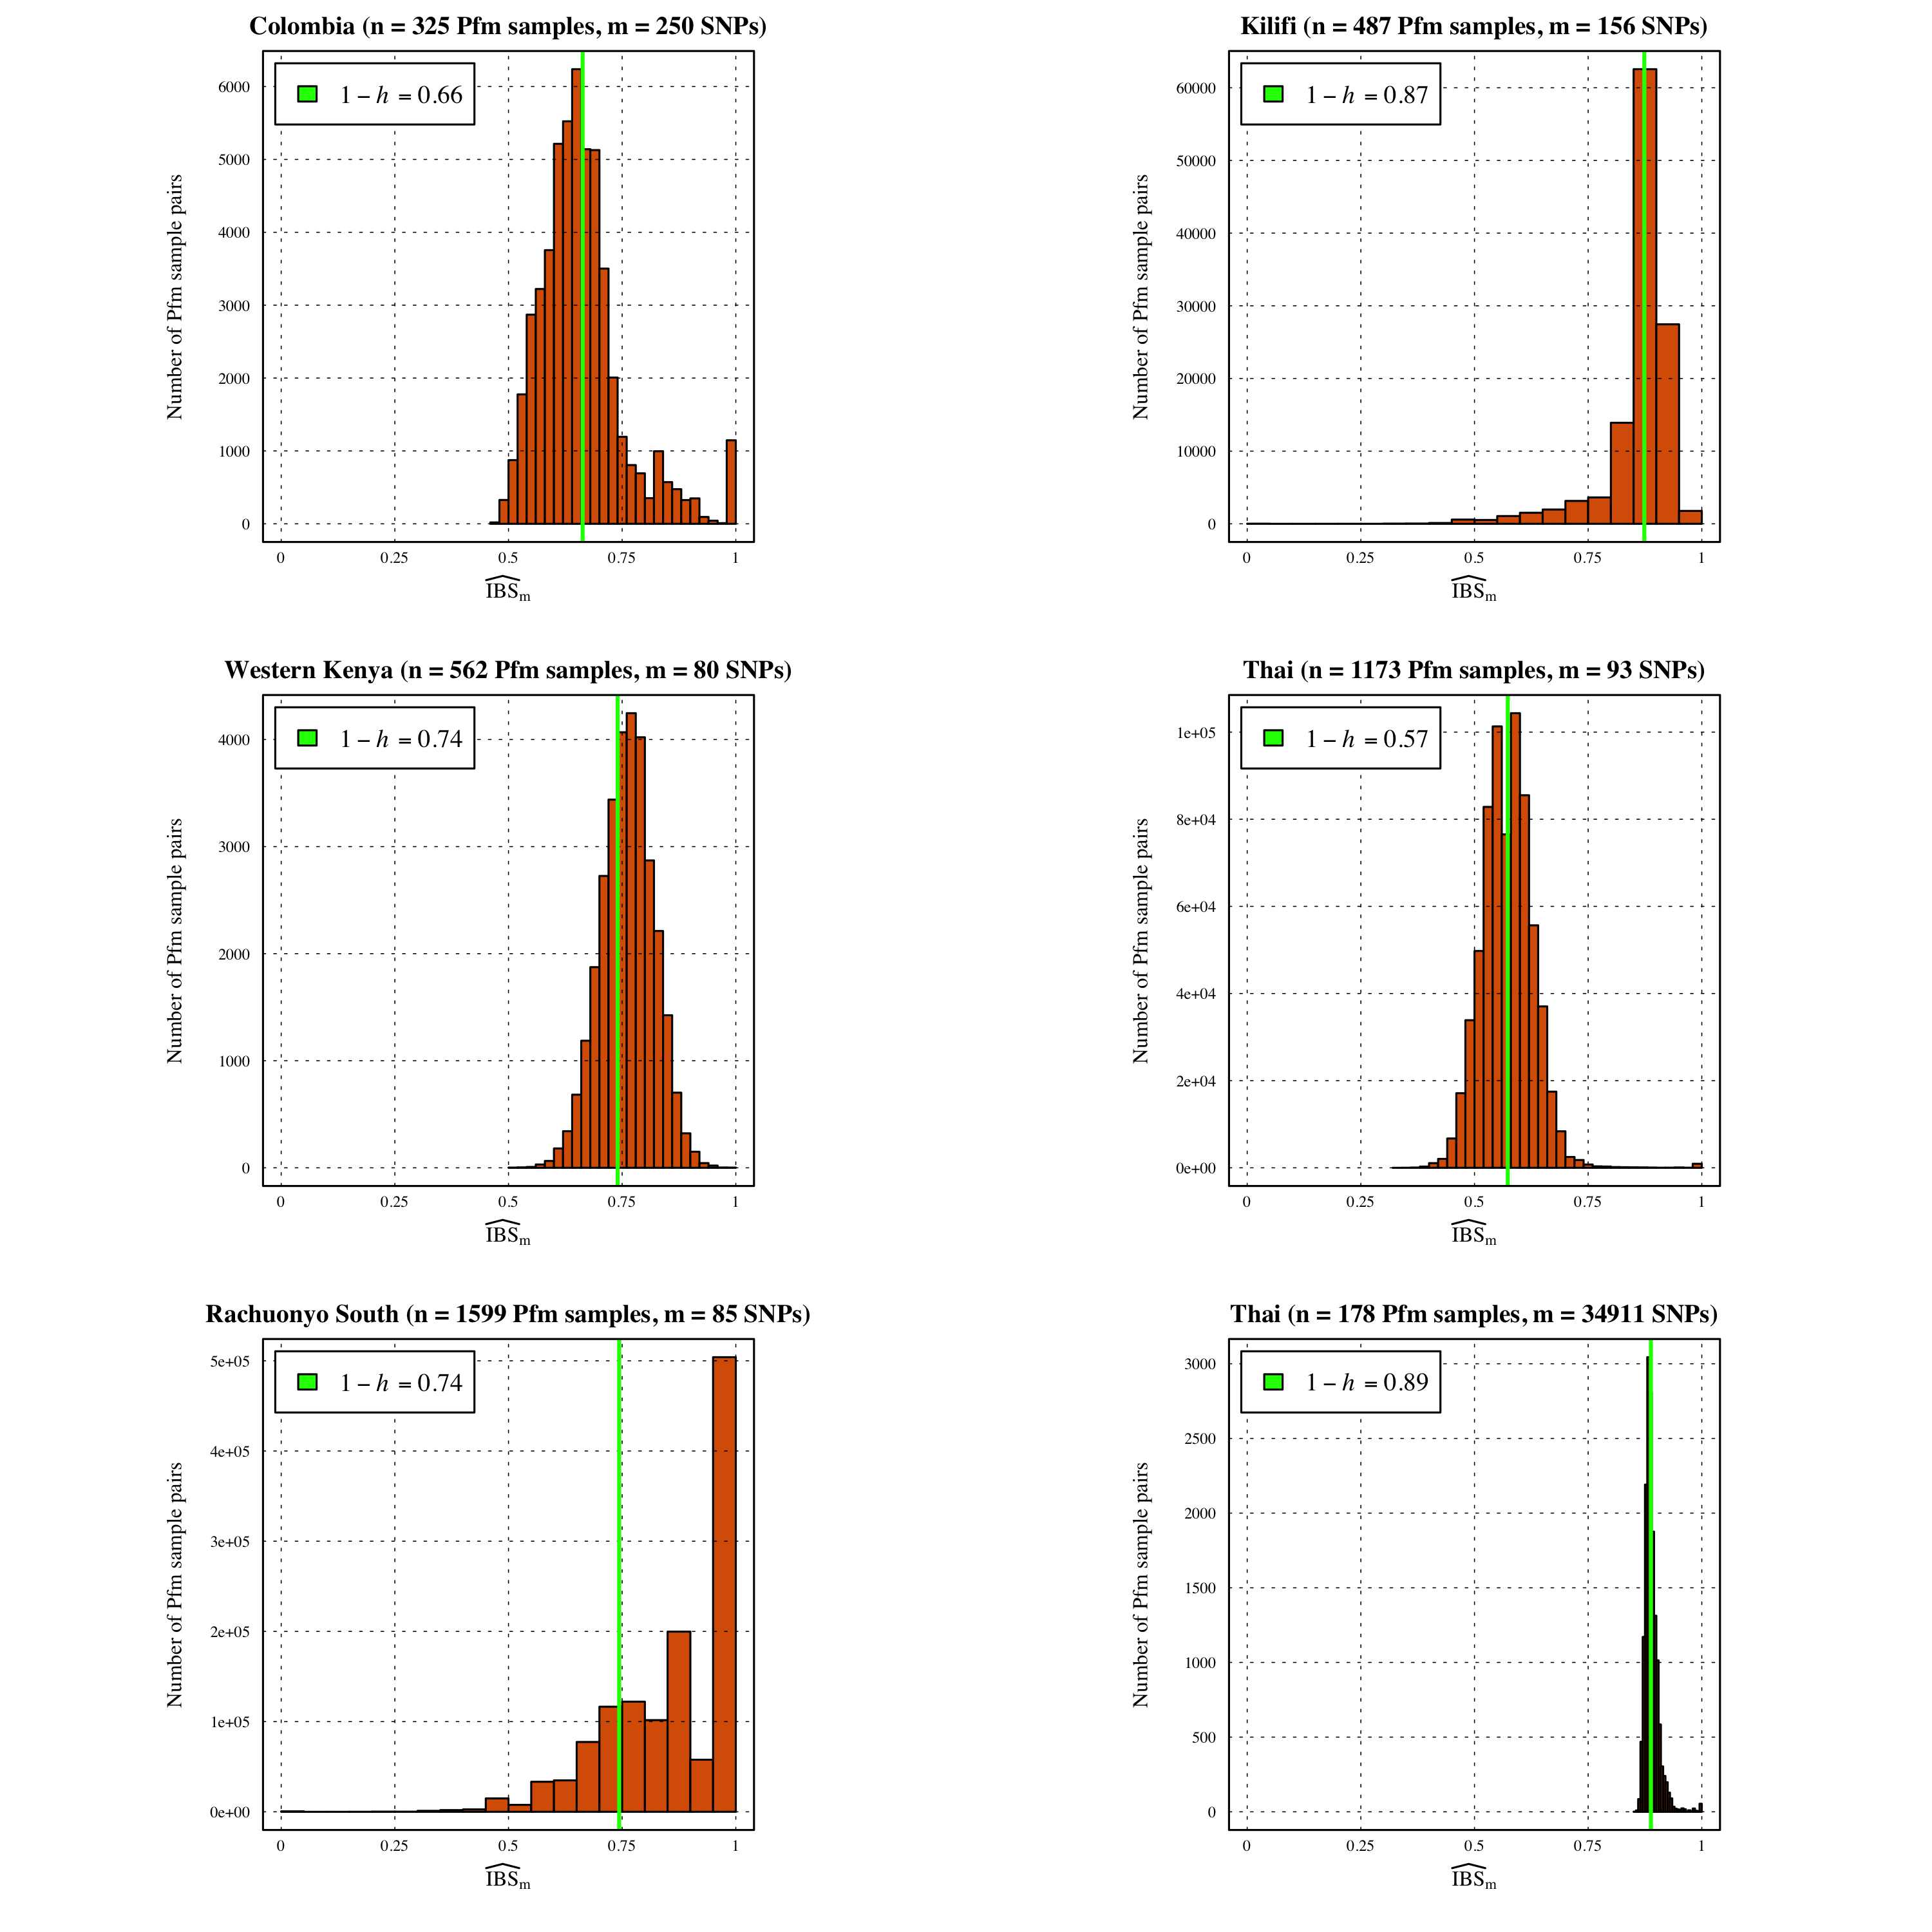
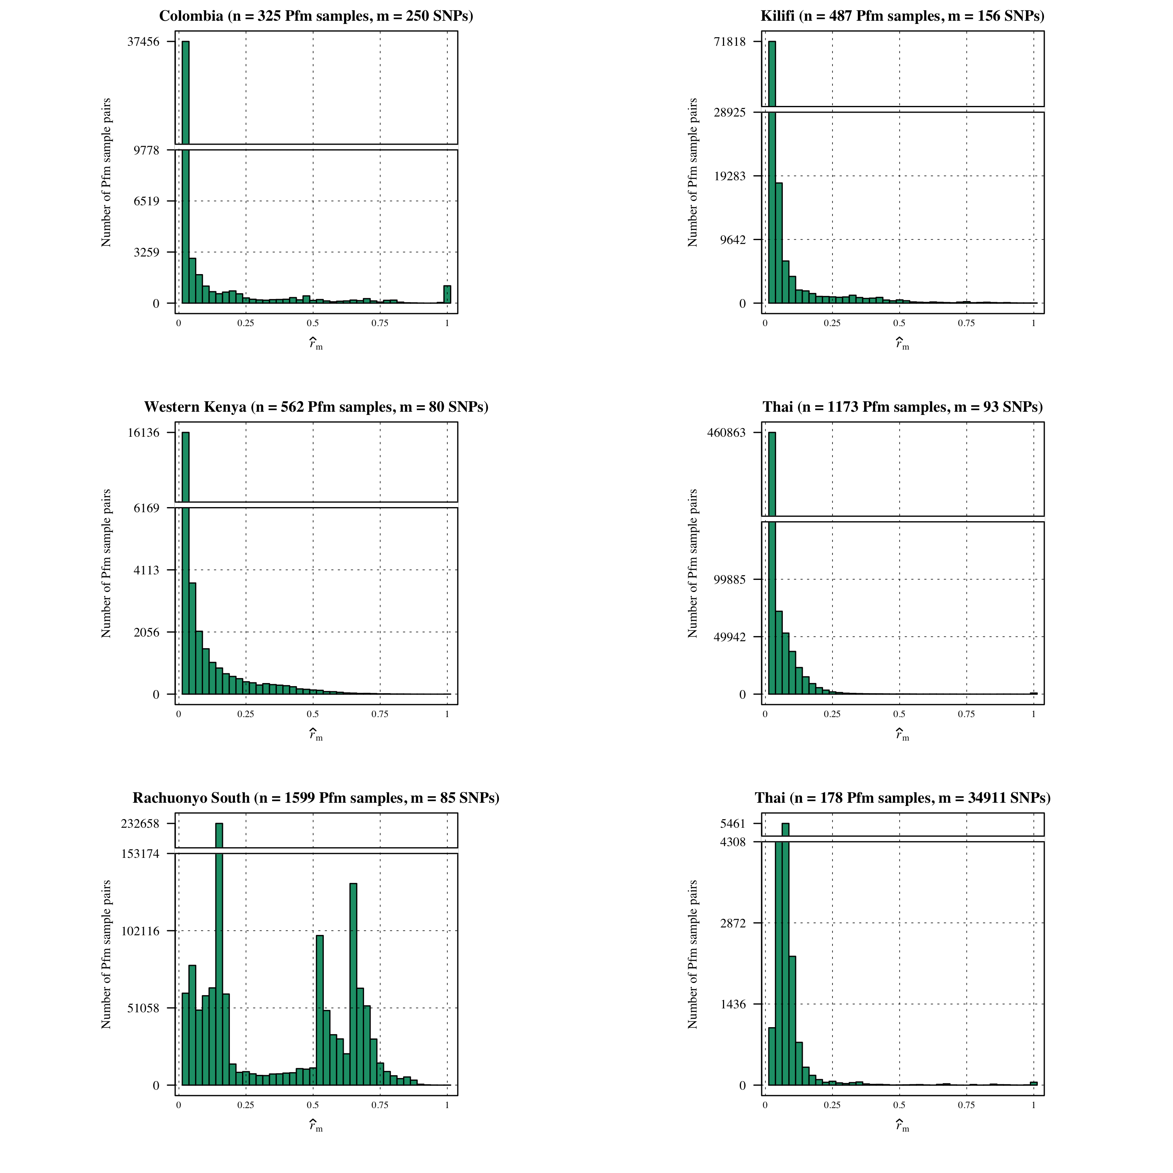
Aside: highly recommend estimating r versus IBS for comparability, SNP requirement and confidence interval calculation
Unpublished

Slide 11
Aside: highly recommend estimating r versus IBS for comparability, SNP requirement and confidence interval calculation
Pre-print on BioRxiv very soon
ataylor@hsph.harvard.edu
Unpublished

Slide 12
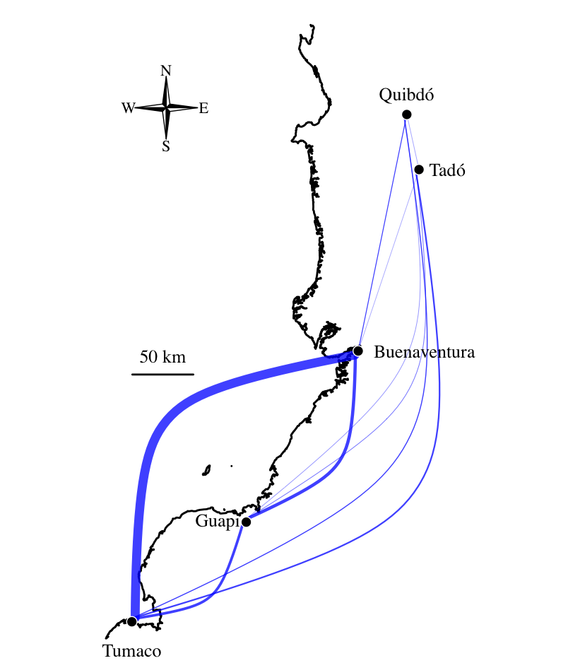
Connectivity across sites only
Blue edges proportional to the proportion highly related between sites
Tumaco and Buenventura are disproportionally connected
Unpublished

Slide 13
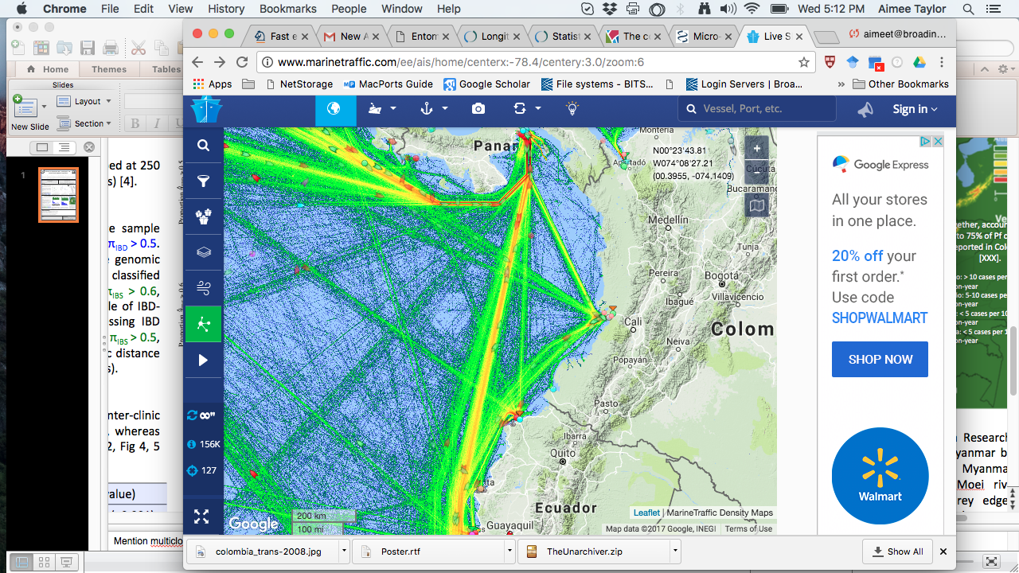
Genetic connectively correlates with maritime traffic
Notes:
Vladimir
Guapi to Buenaventura: fast boat, 6-8 ppl, 4 hr; ship cargo, approx. 50 ppl, 12hr (cheaper);
Tumaco road is a bad road
no public transport between Guapi and Tumaco, only contract fast boat; 1 hr to El Charco (just south of Guapi) and 5hrs from El Charco to Tumaco.
plantain produced in Tumaco is sold in Guapi (and probably Buenventura)
many goods that are received in Buenaventura (the major port of Colombia) are delivered to Tumaco
Diego

Slide 14
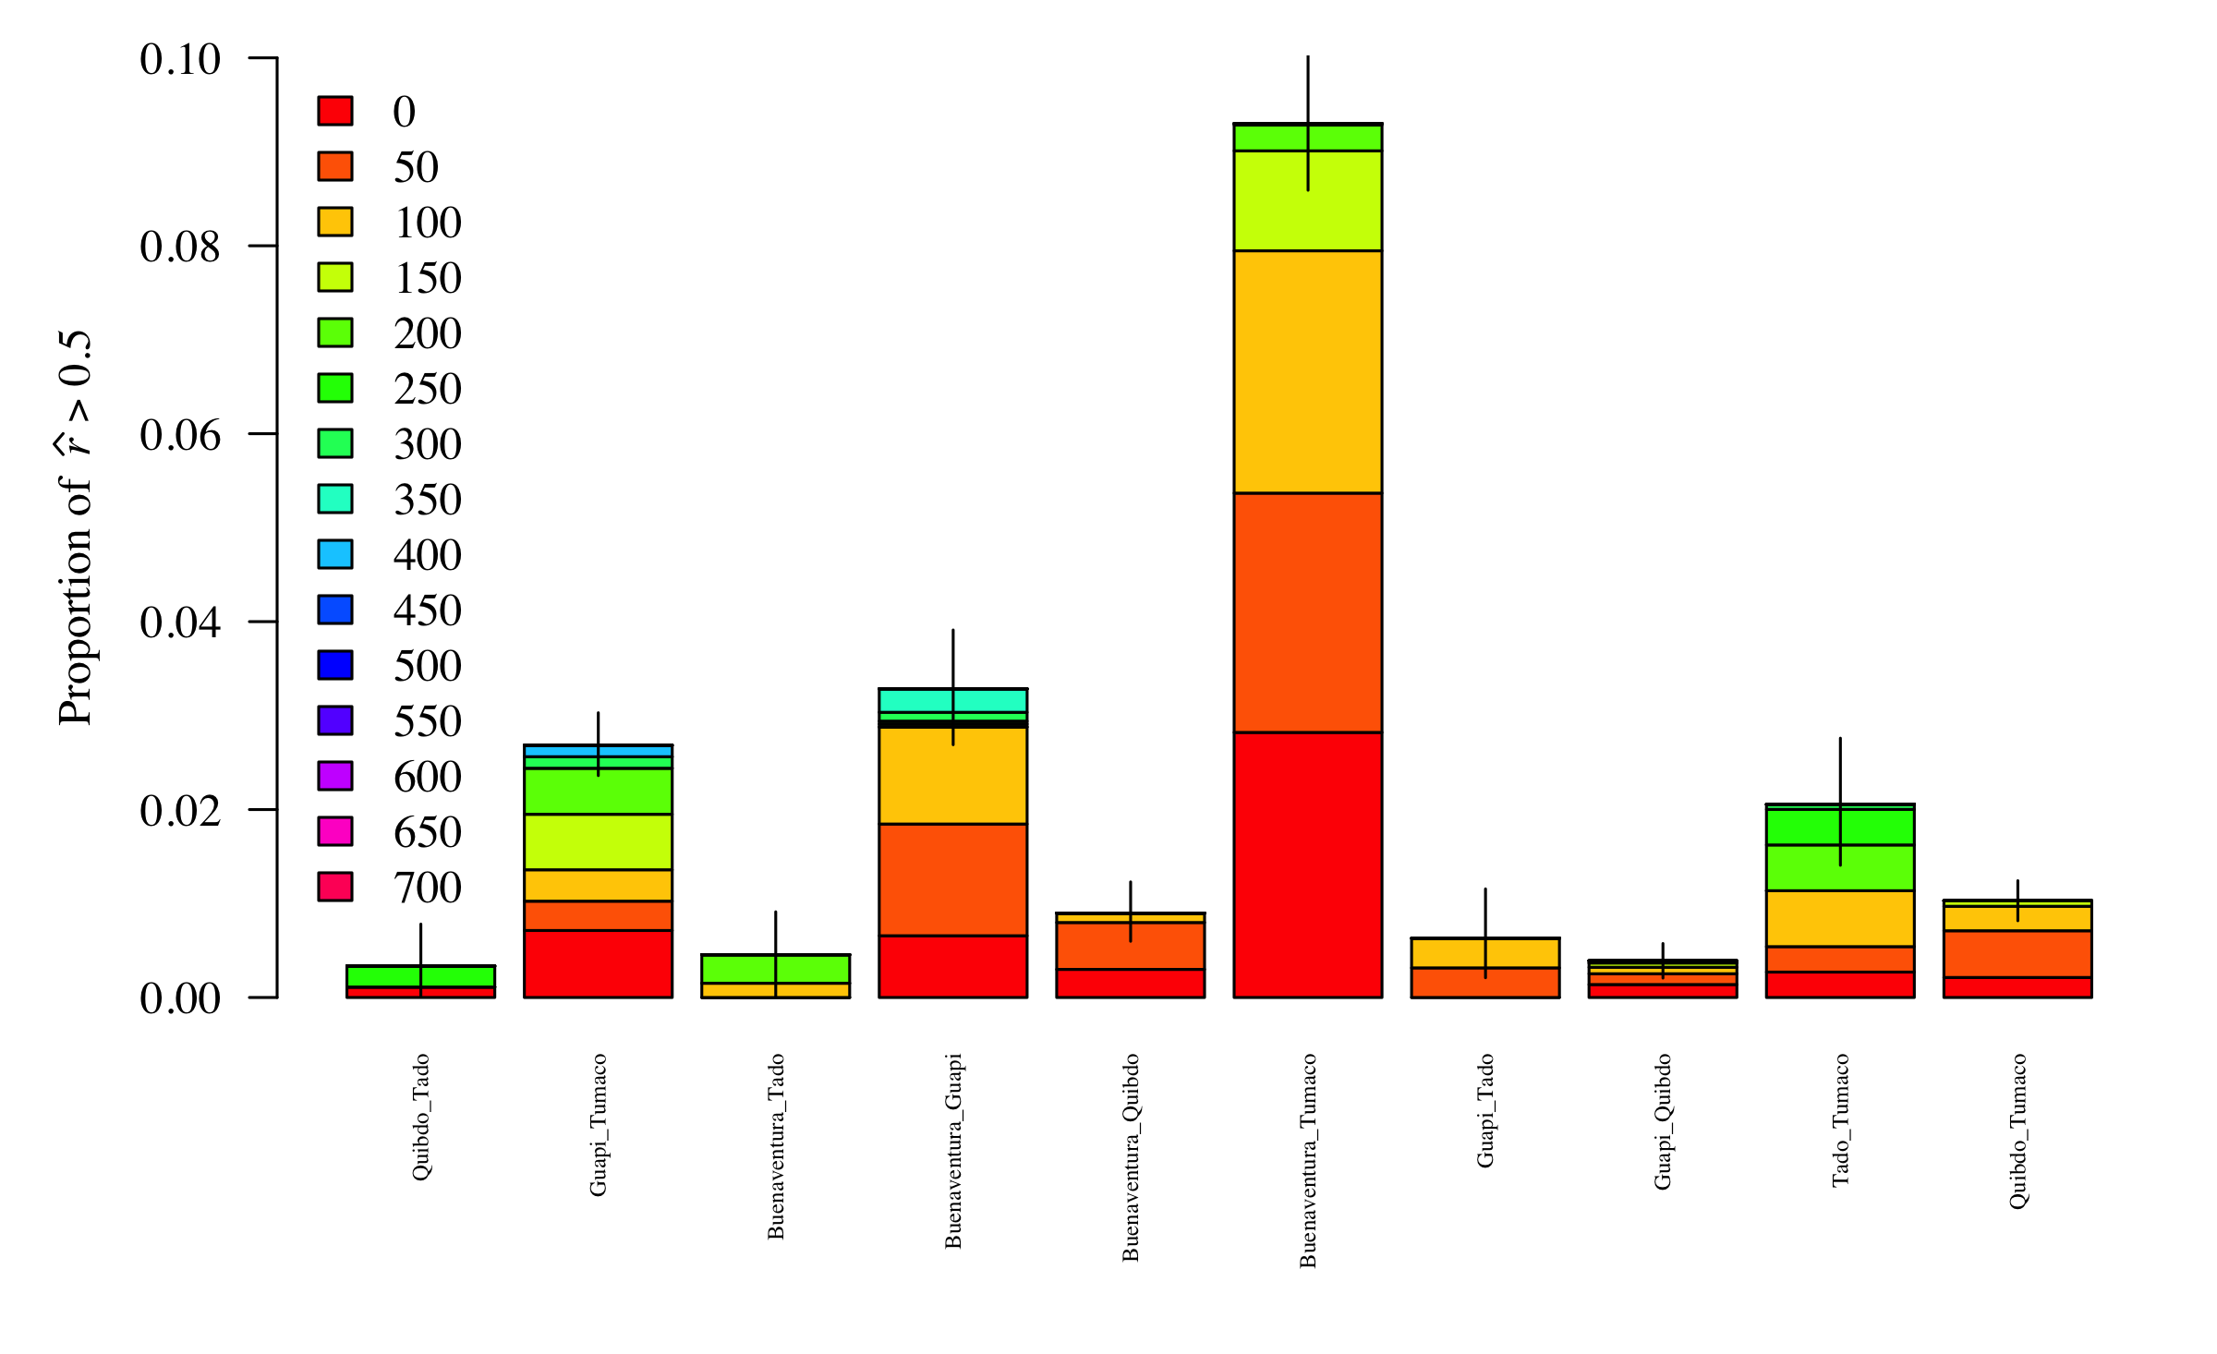
Were port samples all collected at the same time? No
Unpublished

Slide 15
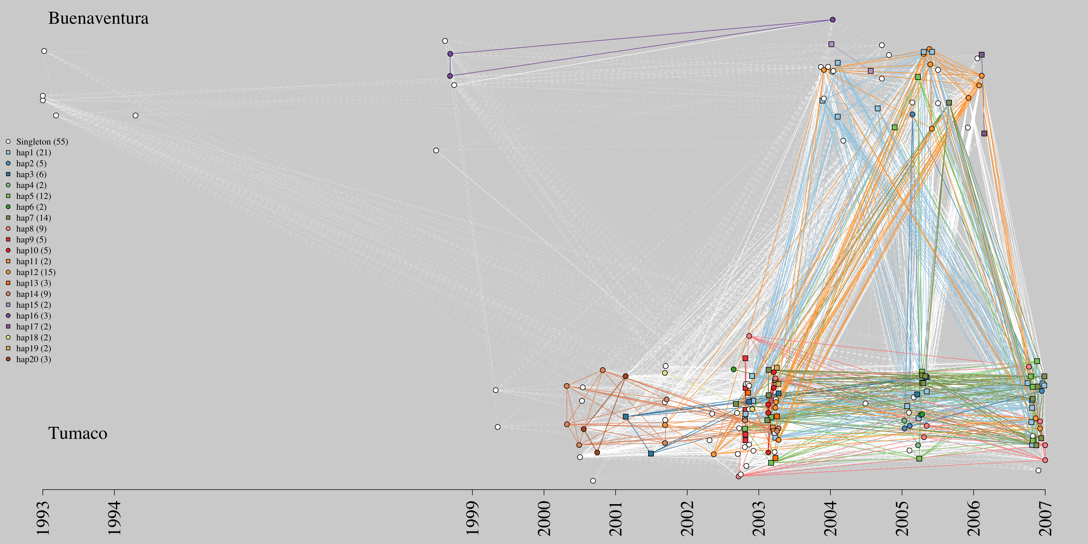
A closer look into the genetic links between ports
Is a single clone driving the signal? No
Pairwise comparisons between ports plotted by sample collection date and colored by haplotype where repeat haplotypes were observed. Solid: IBD > 0.5; dashed: IBD ≤ 0.5
Unpublished

Slide 16
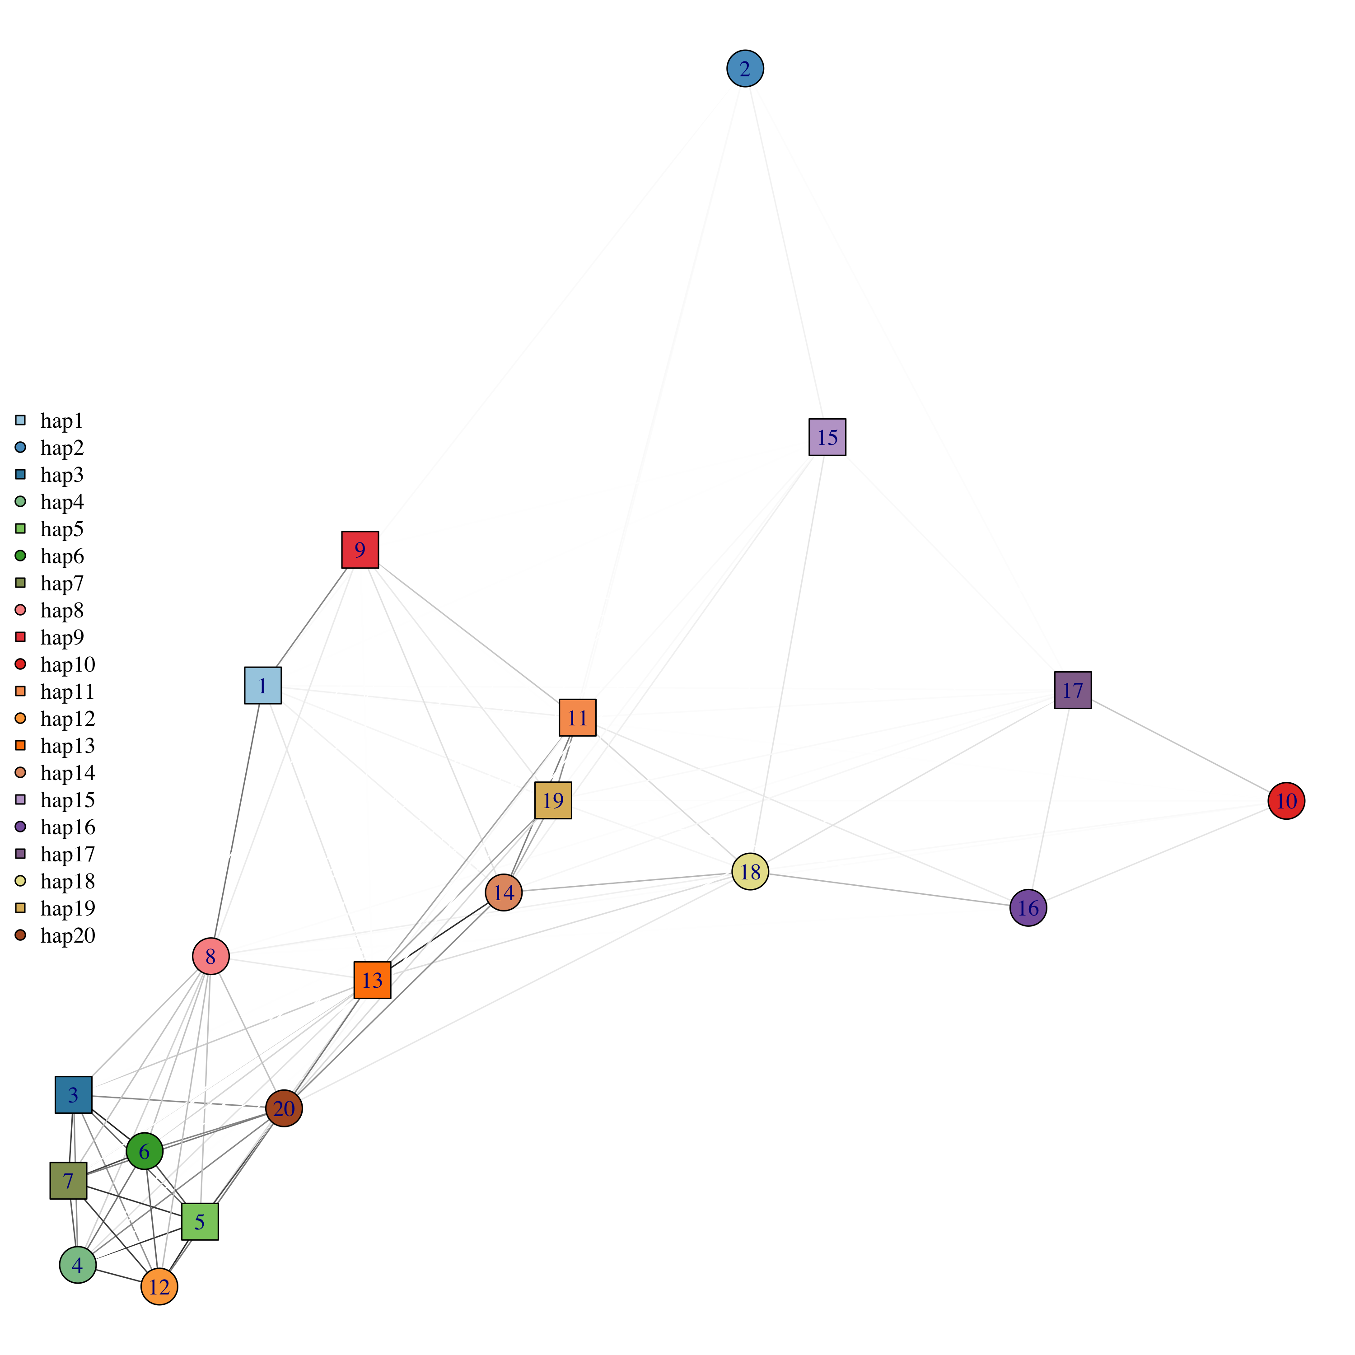
Are the repeat haplotypes highly related to one-another?
Some, not all
Edges = r estimates
Unpublished
Notes:
Make into tree / pca / network
Add interpretation

Slide 17
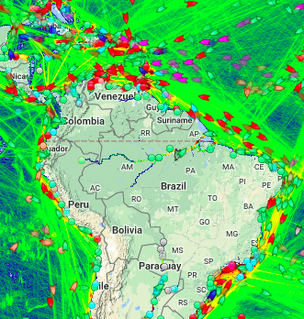



Does marine traffic impact malaria transmission more generally?

Slide 18

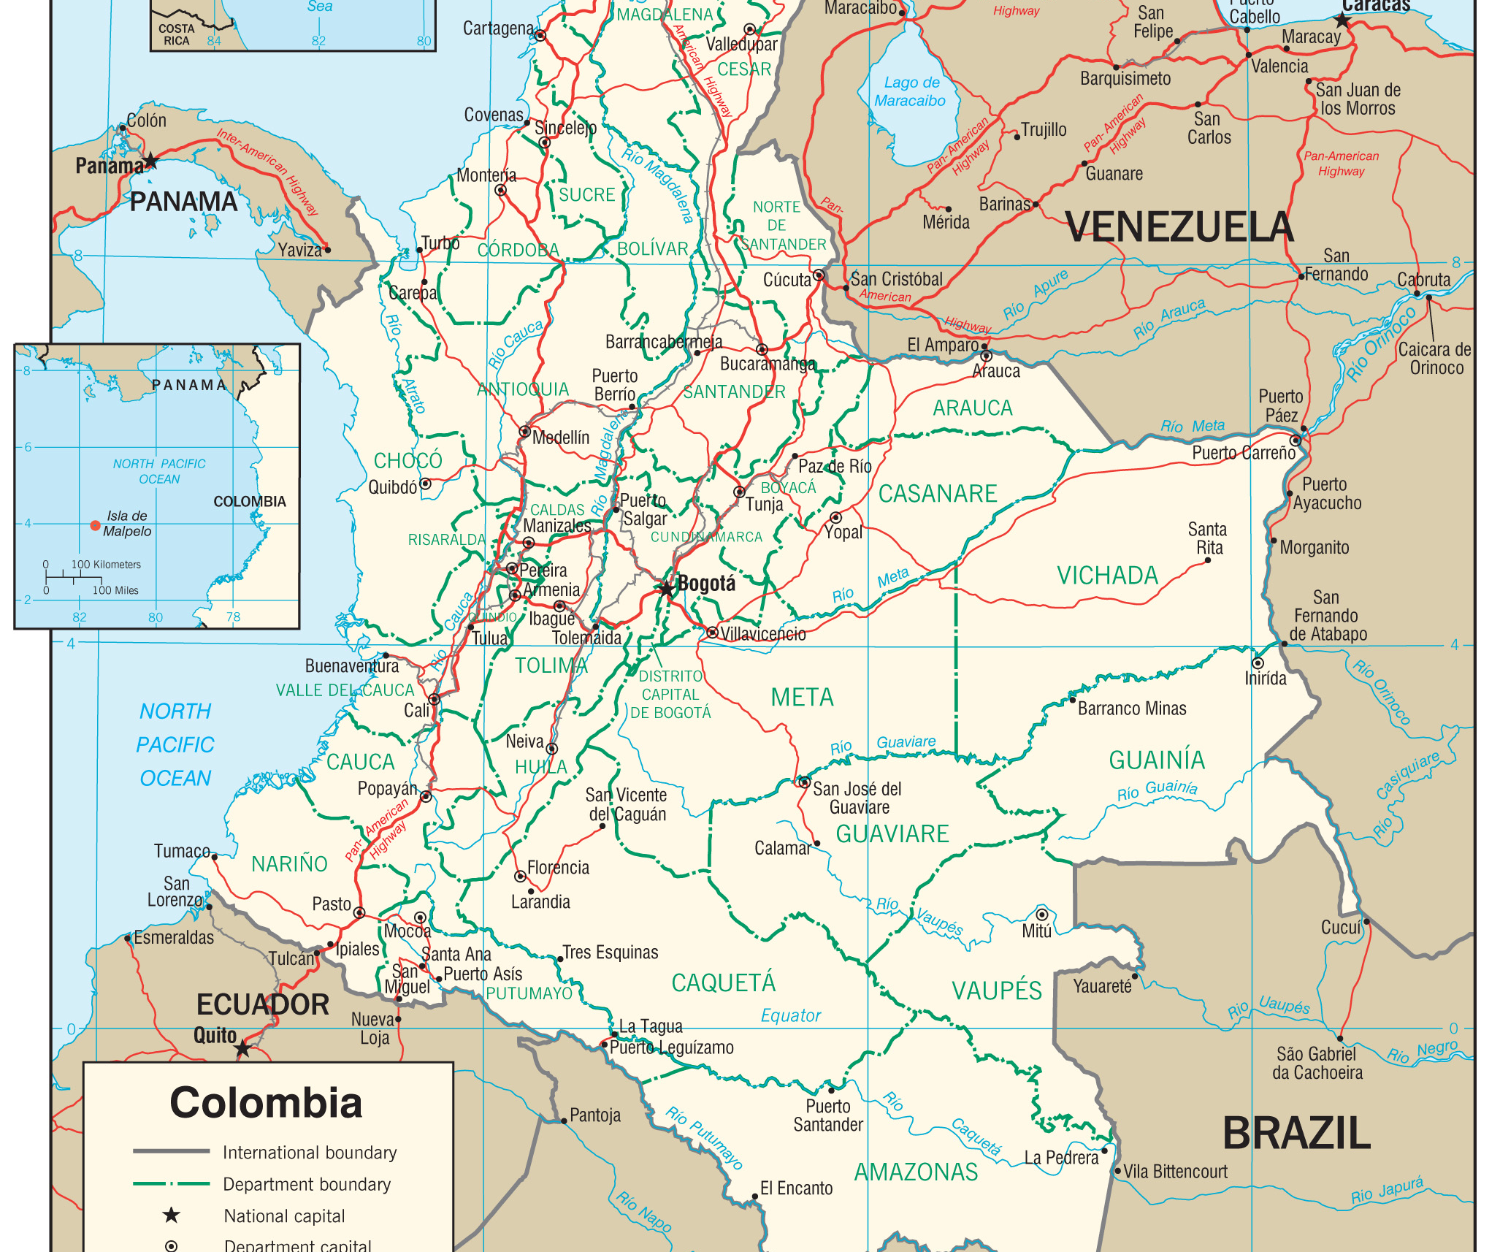
A model framework that allows integration of different data layers
What are dominant processes that drive spatial structure?
How do they differ in different epidemiological settings?
What data are required in different settings?
Extract valuable information from complementary data types while preventing cross-contamination and multiple testing
Works-in-Progress Seminar, Wed, Oct 14th, 1:00-1:50pm, Kresge 502
Notes:
Connectivity in space and time of human and mosquito populations
Human landscape over space and time (census information, world pop, daily migration, long term migration)
Vector population (altitude, forest cover, seasonal variation, bottle necks, global warming)
Policy (bed nets, drug pressures)

Slide 19





Thank you
Aimee R. Taylor
Diego F. Echevarry
Timothy J. Anderson
Daniel E. Neafsey
Caroline O. Buckee

